Slide 1
Linear Regression of Life Expectancy
Presented by:
Katya Mora
Andres Gonzalez
Christina Lopez
Notes:
Katya: slides 2 - 9
Andres: slides 10-17
Christina: slides 18-25

Slide 2
Table of Contents
Introduction to Data Set
Analysis Questions
Study Findings
Exploratory Data Analysis
Discussion of Results
Conclusion

Slide 3
The Study
Health-related data from the World Health Organization repository was merged with economic-related data from the United Nations website.
The data was made public in order to help countries improve its citizens life expectancy.
A representative for a country with low life expectancy can use the health and economic related variables and regression analysis to determine where to focus its resources for improvement.
The data set contains life expectancy, health-related data, and economic-related data of 193 different countries between the years 2000-2015.
Variables: Adult Mortality, Polio, GDP, Schooling, and more!
Subset of data to analyze
Focus on developing countries in the year 2014
112 observations
Source: https://www.kaggle.com/datasets/kumarajarshi/life-expectancy-who

Slide 4
Description of Variables of interest
Response:
Life expectancy - Life Expectancy in age
Categorical Variables:
Year - 2000-2015 (We will focus on 2014)
Status - is this country developed or developing) we conduct analysis on developing
Country - 193 countries
Prediction Variables
Adult Mortality - Adult Mortality Rates of both sexes (probability of dying between 15 and 60 years per 1000 population
Total expenditure - General government expenditure on health as a percentage of total government expenditure (%)
HIV/AIDS - Deaths per 1,000 live births HIV/AIDS (0-4 years)
Income composition of resources - Human Development Index in terms of income composition of resources (index ranging from 0 to 1)

Slide 5
Analysis Questions For Developing Countries in 2014
Which countries had the highest life expectancy? → Plot the life expectancy per country
Which variables best predict life expectancy? → AIC to select variables of interest
Are there any interactions between variables used to predict life expectancy? → F test on the model with interaction terms
Are each of the predictors positive or negatively correlated to life expectancy? → Scatterplot matrix with correlation matrix
Make a 95% point prediction for the life expectancy of a country with predictor values as the mean response of each predictor. → Prediction interval

Slide 6
Study Findings
Predictor variables:
Income composition of resources
Adult mortality
HIV/AIDS
Total Expenditure
Interaction variables:
Income composition of resources : Total expenditure
Income composition of resources : HIV/AIDS
Model
Life Expectancy | = | Income composition | + | Adult mortality | + | HIV/ AIDS | + | Total expenditure | + | Income composition * Total expenditure | + | Income composition * HIV / AIDS

Slide 7
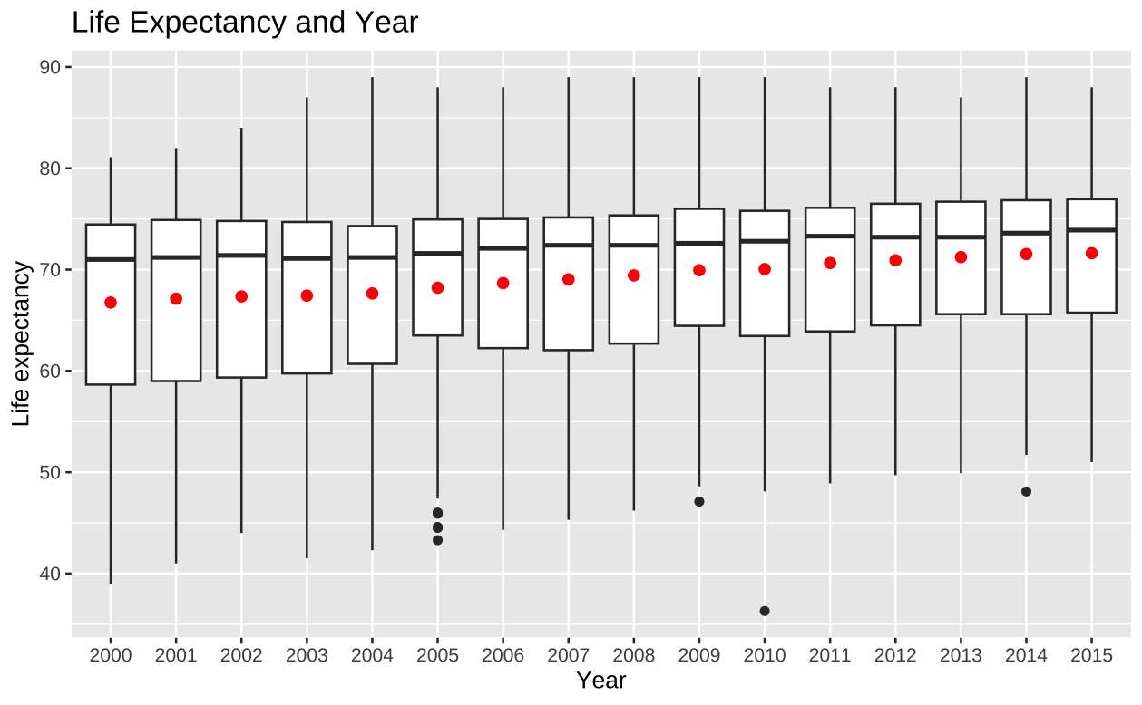
Exploratory Data Analysis
Box plot of countries life expectancy by year from year 2000 to 2015.
Red point represents the mean of life expectancy for each year.
Outliers in the year 2005, 2009, 2010 and 2014.
For our analysis, we will focus on data in year 2014.

Slide 8
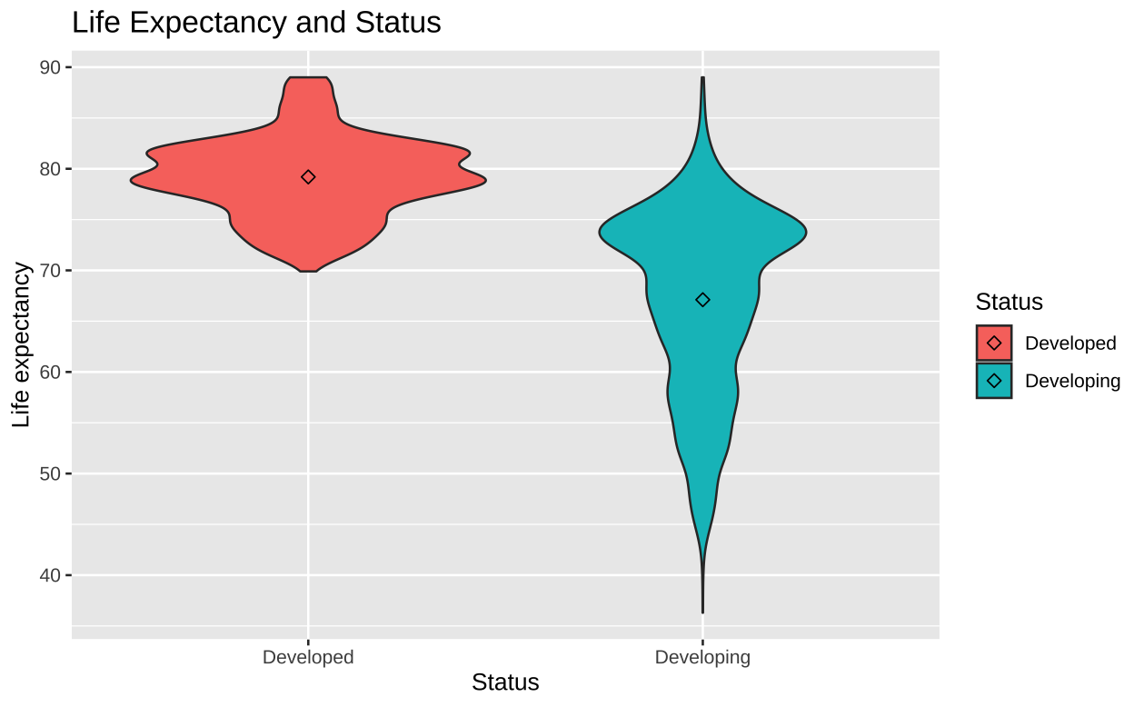
Exploratory Data Analysis
Violin plot of countries life expectancy and status.
There are only two types of status which are developed and developing countries.
We see that the overall shape and distribution of the life expectancies are not similar for both statuses.
The diamond shape represents the mean of the life expectancy.
For our analysis, we will focus on developing countries

Slide 9
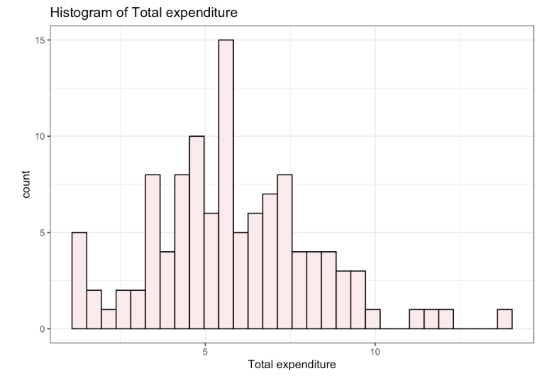
Exploratory Data Analysis
Total expenditure - General government expenditure on health as a percentage of total government expenditure (%)
Appears to have a normal distribution, about 6% has the highest count for percent of expenditure on health.

Slide 10
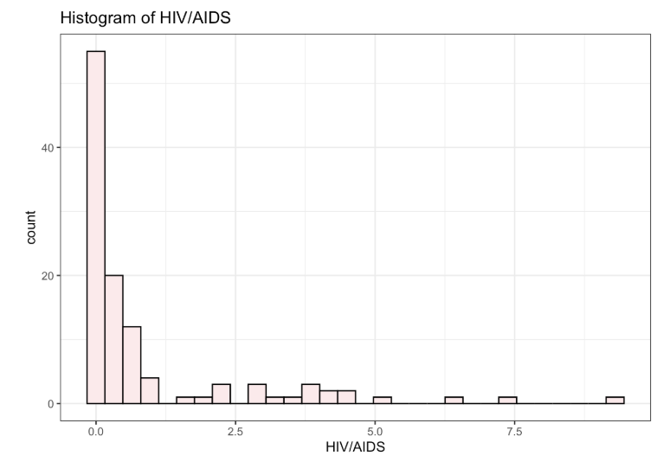
Exploratory Data Analysis
Deaths per 1,000 live births HIV/AIDS (0-4 years)
Highest count of deaths were for 0-1 years.
Resources could be a possibility for such high count of deaths happening so early.

Slide 11
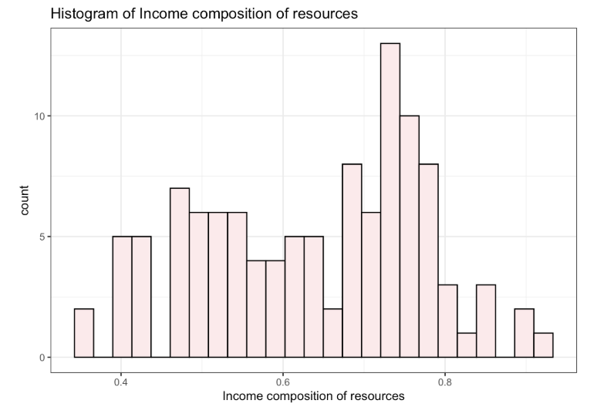
Exploratory Data Analysis
Income composition of resources - Human Development Index in terms of income composition of resources (index ranging from 0 to 1)
Data appears to be skewed left, countries have high income composition of resources

Slide 12
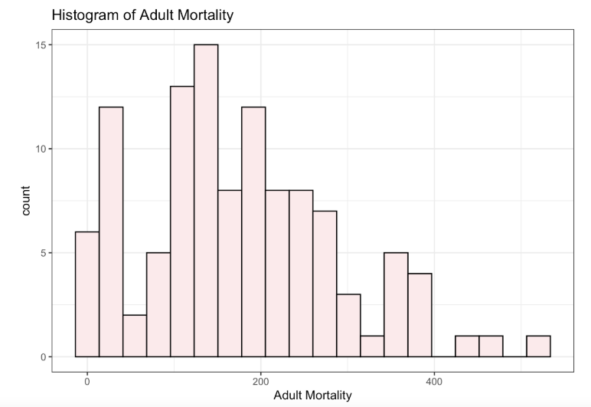
Exploratory Data Analysis
Adult Mortality - Adult Mortality Rates of both sexes (probability of dying between 15 and 60 years per 1000 population
Data appears skewed right

Slide 13
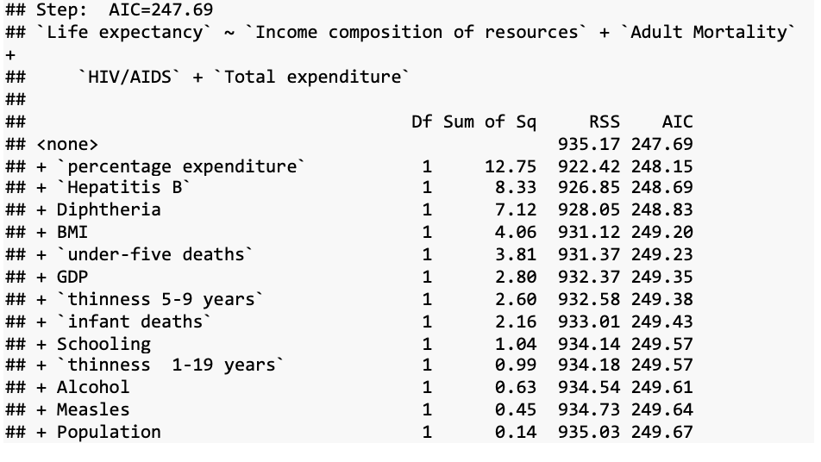
Which variables best predict life expectancy in developing countries in 2014?
Just a quick glance at 4 predictor model with life expectation as the response and Income composition of resources, Adult mortality, HIV/AIDS and Total expenditure as our predictors.
We used Stepwise Regression AIC for variable selection.

Slide 14
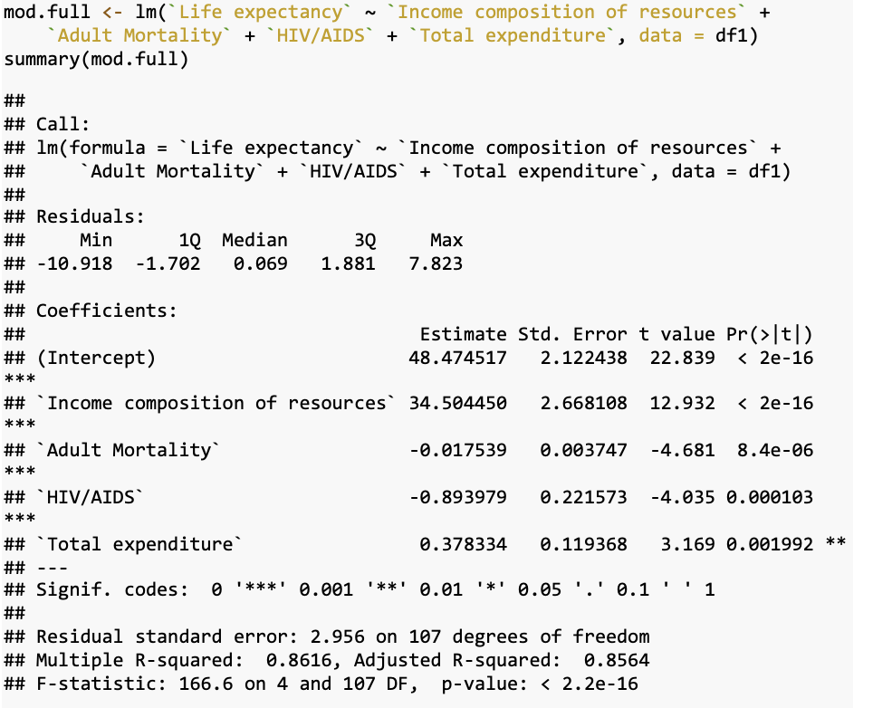
Summary of full model without interaction effect
R-Squared: 0.8616, AIC: 247.69
Predictors are significant since all their p-values less than alpha of 0.05.
Relationship is at least significant here!

Slide 15
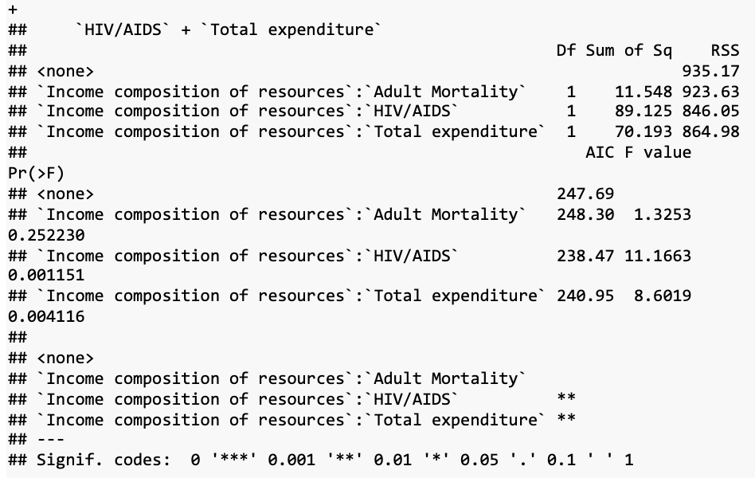
Are there any interactions between predictors?
Add interaction terms using the predictor “Income composition of resources” to all other predictors from the model.
Interaction terms: `Income composition of resources:`HIV/AIDS’ and `Income composition of resources`:`Total expenditure` are significant!

Slide 16

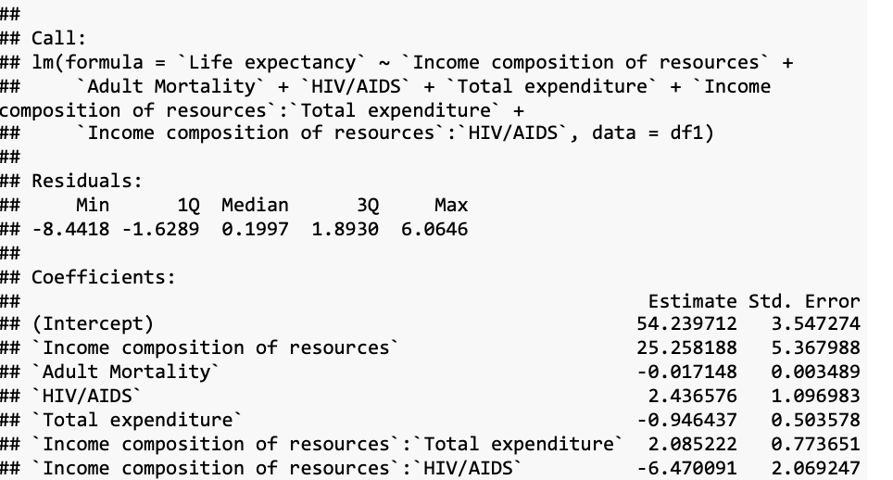
Summary of full model with interaction effect
Updated the model by adding the interaction terms that were significant
R- Squared: 0.8829
Adjusted: 0.8762
In the summary output all predictors and interaction terms are significant except for Total expenditure, but we are still including it since p - value is slightly greater than 0.05

Slide 17
Coefficient Interpretation
For every unit increase in Income composition of resources, the life expectancy increases by 25.26 while controlling for Adult mortality, HIV/AIDS, Total expenditure, and interaction terms.
For every unit increase in Adult Mortality, the life expectancy decreases by 0.017 while controlling for, HIV/AIDS, Total expenditure, Income composition of resources and interaction terms.
For every unit increase in HIV/AIDS, the life expectancy increase by 2.44 while controlling for Adult mortality, Total expenditure, Income composition of resources and interaction terms.
For every unit increase in Total Expenditure, the life expectancy decreases by 0.946 while controlling for Adult mortality, HIV/AIDS, Income composition of resources and interaction terms.

Slide 18
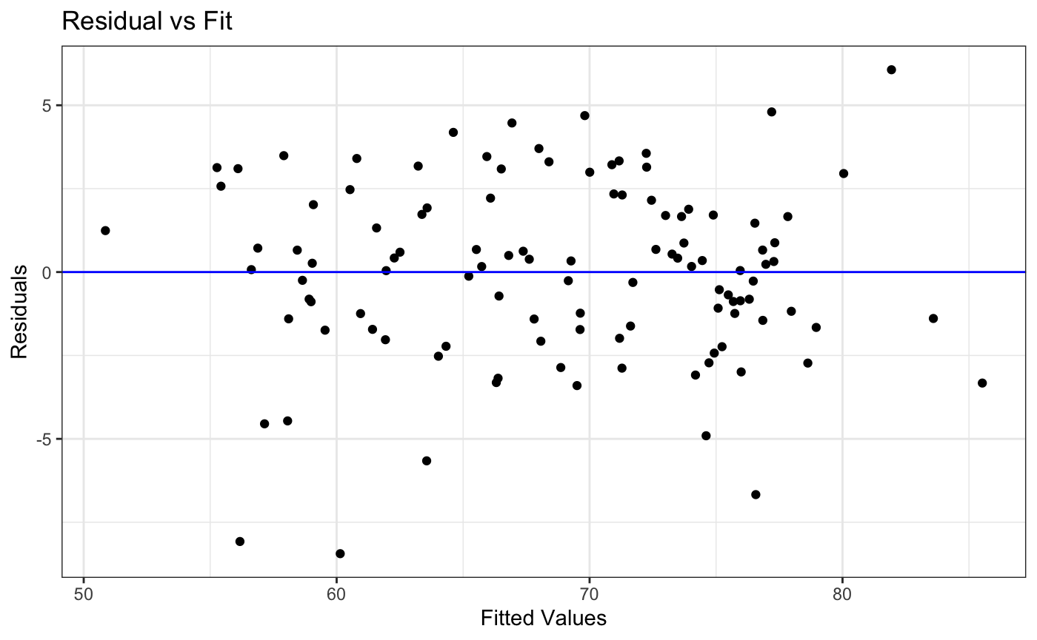
Check LINE Assumptions (Linearity & Equal Variance)
Plot is “Well-Behaved”
Non-linearity is not a problem.
The errors have equal variances.
No need to do any transformations on x or y to the model.

Slide 19
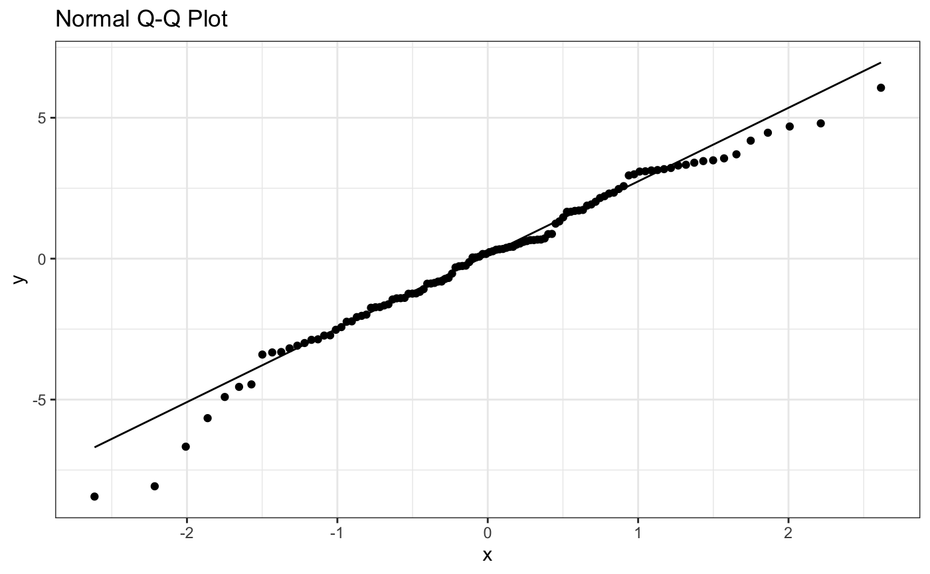
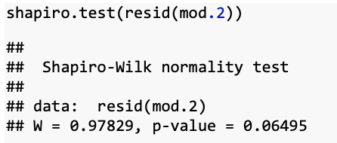
Check LINE Assumptions (Normality)
It is normally distributed.
Also, in the shapiro test we fail to reject the null hypothesis since 0.06 > 0.05 = alpha, so we don’t do any transformation on y.

Slide 20
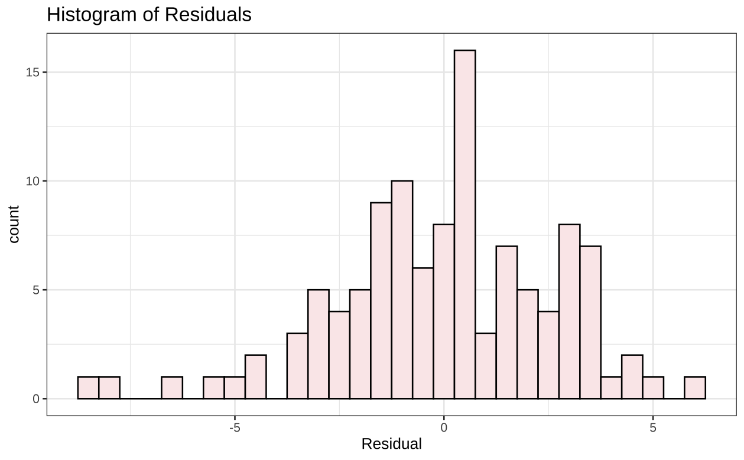
Check LINE Assumptions (Normality)
Model Looks normally distributed.
This is further indication that a transform is not required.

Slide 21
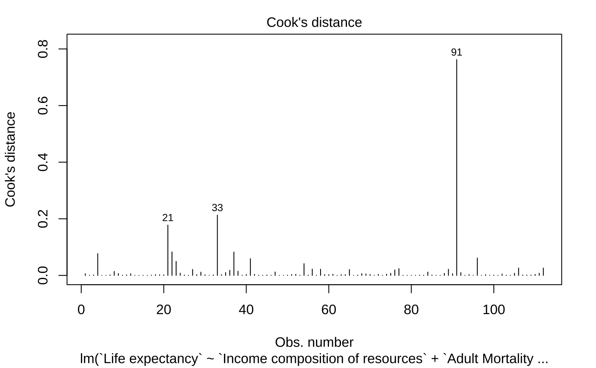
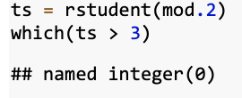
Check For Outliers
No outliers in the model!
So we don’t remove any observation rows from the data frame.

Slide 22
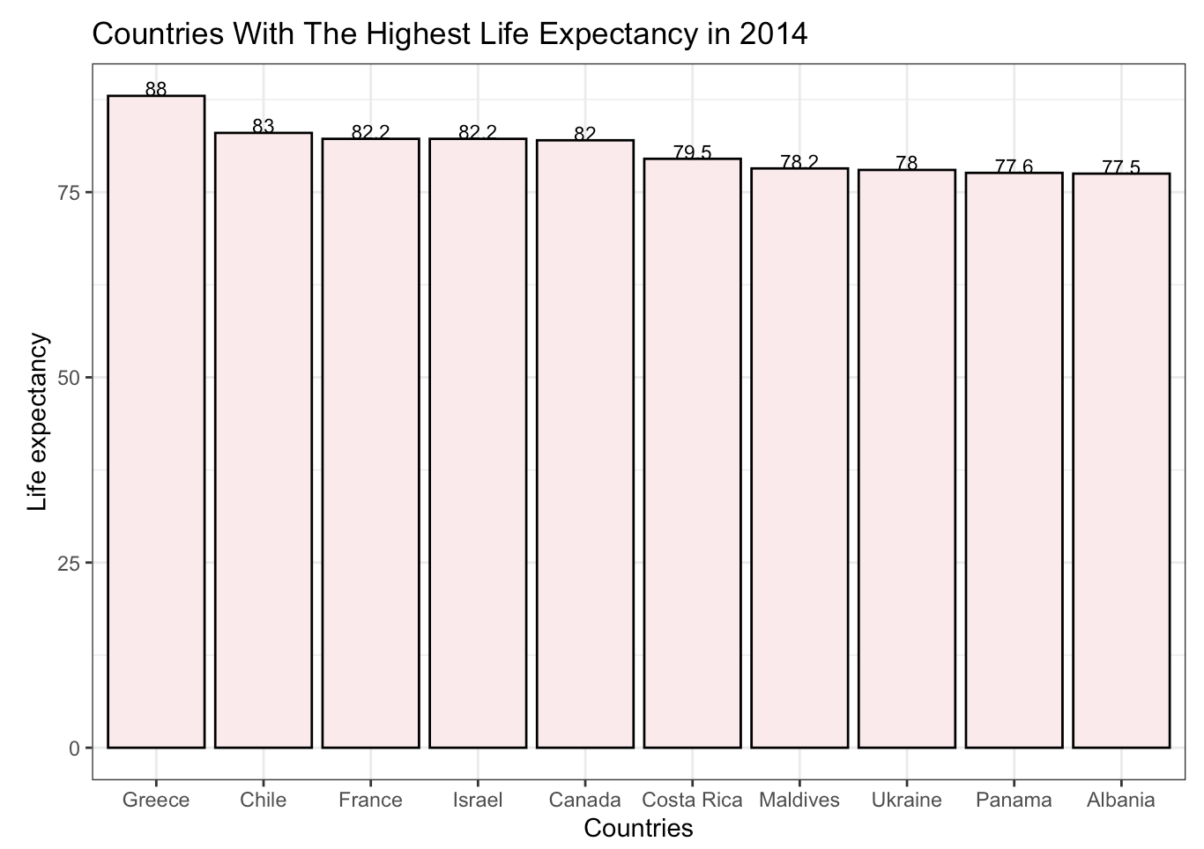
Which developing country had the highest life expectancy in 2014?
Greece had the highest life expectancy in 2014 with 88 years of age.

Slide 23
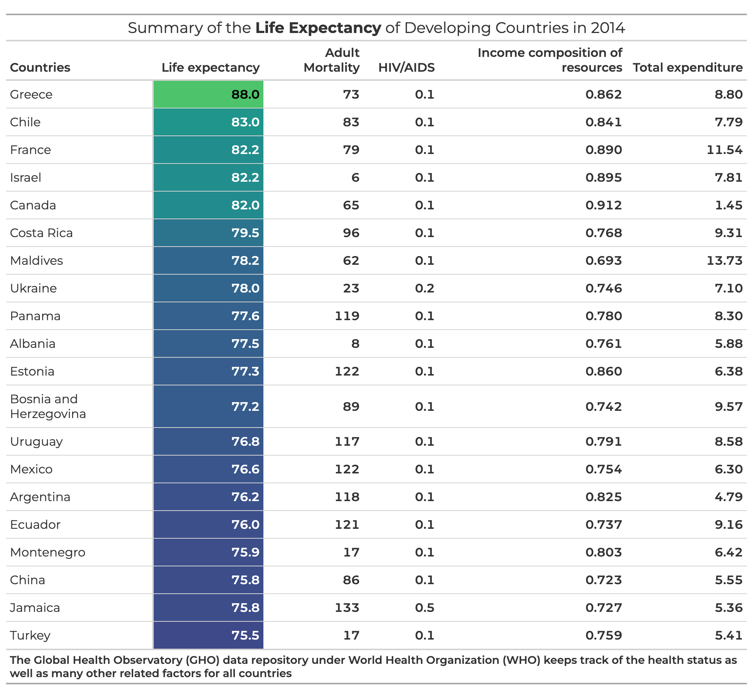

Slide 24
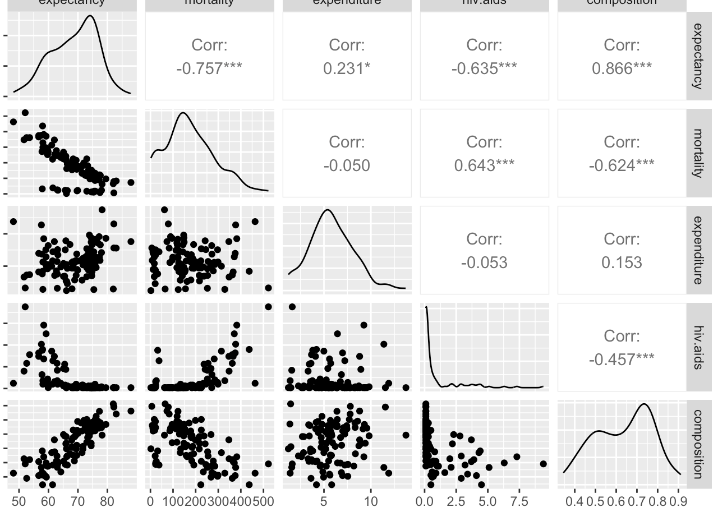
Are each of the predictors positive or negatively correlated to life expectancy?
Life expectancy has a:
Positive correlation with Total Expenditure and Composition.
Negative correlation with Mortality and HIV/AIDS.

Slide 25
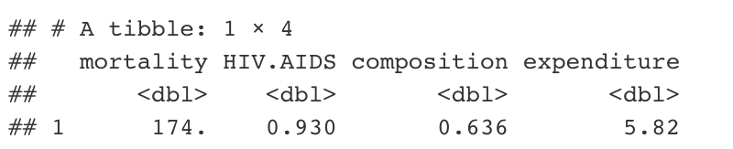

Make a 95% prediction for the life expectancy of a country with predictors as mean of each predictor
The mean values for each predictor are shown in the table to the left
The life expectancy of a country with these values is expected to be 67.97. The 95% prediction interval is [62.48, 73.45]

Slide 26
Conclusion
We can significantly predict life expectancy in developing countries in 2014 using data from the WHO repository and United Nations website.
88% of the variation in life expectancy is explained by these 4 predictors and 2 interaction terms.
2 of the prediction variables are economic-related data and are both positively correlated with life expectancy.
2 of the variables are health-related data and are both negatively correlated with life expectancy.
The life expectancy is expected to be 67.9 for a country that has the mean of each predictor variable

Slide 27

Thank you

